Slide 1
신경과의 말초신경근육 질환
노원을지병원 신경과
유일한

Slide 2
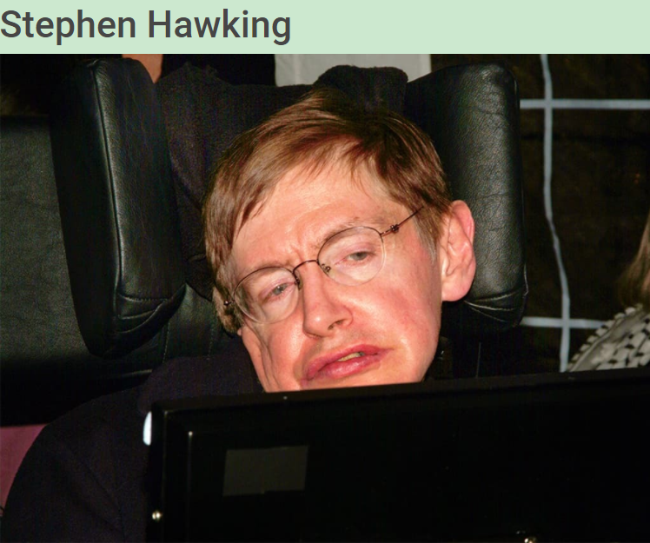




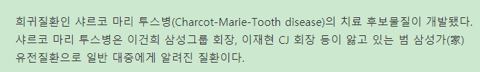
Ann Romney, wife of former presidential contender Mitt Romney
Amyotrophic lateral sclerosis (ALS)
https://alstreatment.com/famous-people-with-als/
https://neuronup.us/cognitive-stimulation-news/acquired-brain-injury/stroke/celebrities-with-neurological-and-mental-disorders/
https://www.webmd.com/multiple-sclerosis/ss/slideshow-faces-of-ms

Slide 3
신경과의 말초신경 근육질환 파트에서 보는 질환
Central nervous system (CNS) demyelinating disease
Multiple sclerosis (MS)
Neuromyelitis optica spectrum disorder (NMOSD)
etc.
Spinal cord disease (myelopathy)
Muscle disease

Slide 4
Case 1
21 year old, woman
vision loss 5 days ago in right eye, gradual onset, progression
Periocular pain worsened by eye movement.
right relative afferent pupillary defect (RAPD), visual acuity of 20/70 in right eye.

Slide 5
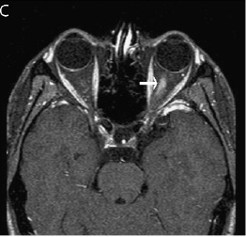

Slide 6
Multiple sclerosis
Massimo Filippi, 2018

Slide 7
MS
NMO
Ho-jin Kim, 2015

Slide 8
Case 2
A 30-year-old woman with 6-month history of bilateral ptosis, diplopia, intermittent mild dysphagia, neck heaviness
Creatine kinase level: normal
Acetylcholine receptor (Ach), muscle-specific tyrosine kinase antibodies: (-)
Repetitive nerve stimulation test: normal
Single-fiber EMG of frontalis: abnormally increased jitter with increased fiber density
Pyridostigmine treatment: improvement
Michael W. Nicolle, 2016

Slide 9
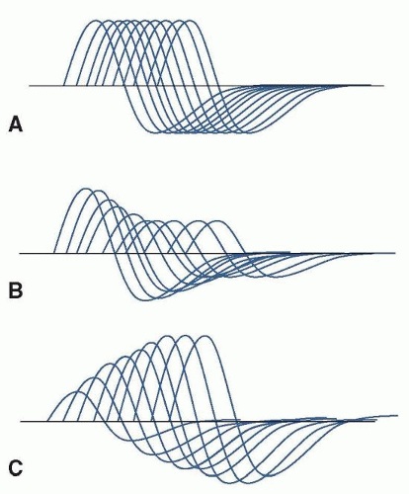
Myasthenia gravis
Weakness increase with repetitive use, day
progress.
Diplopia, ptosis, dysarthria, dysphagia
Repetitive nerve stimulation test
Acetylcholine receptor antibody, muscle-specific tyrosine kinase antibody
Pyridostigmine and immunosuppressive drugs
Thymectomy
Nils Erik Gilhus, 2019
https://neupsykey.com/myasthenia-gravis-and-disorders-of-the-neuromuscular-junction/

Slide 10
Emma Ciafaloni, 2019

Slide 11
Case 3
A 67-year-old man, 8-month history of progressive slurring of speech
Weakness of left hand without numbness
Muscle cramping in his hands and legs
Cry spontaneously (unusual for him)
Neurologic exam
spastic and flaccid dysarthria
fasciculation of tongue, arms, thighs
Atrophy of tongue and left hand
Arm and leg reflexes were brisk.
Extensor plantar response, positive Hoffman sign
Brain MRI, spine MRI: unremarkable
Needle EMG: fibrillation and positive sharp waves in hand muscles, leg muscles, thoracic paraspinal muscles.
Colin Quinn, 2020

Slide 12
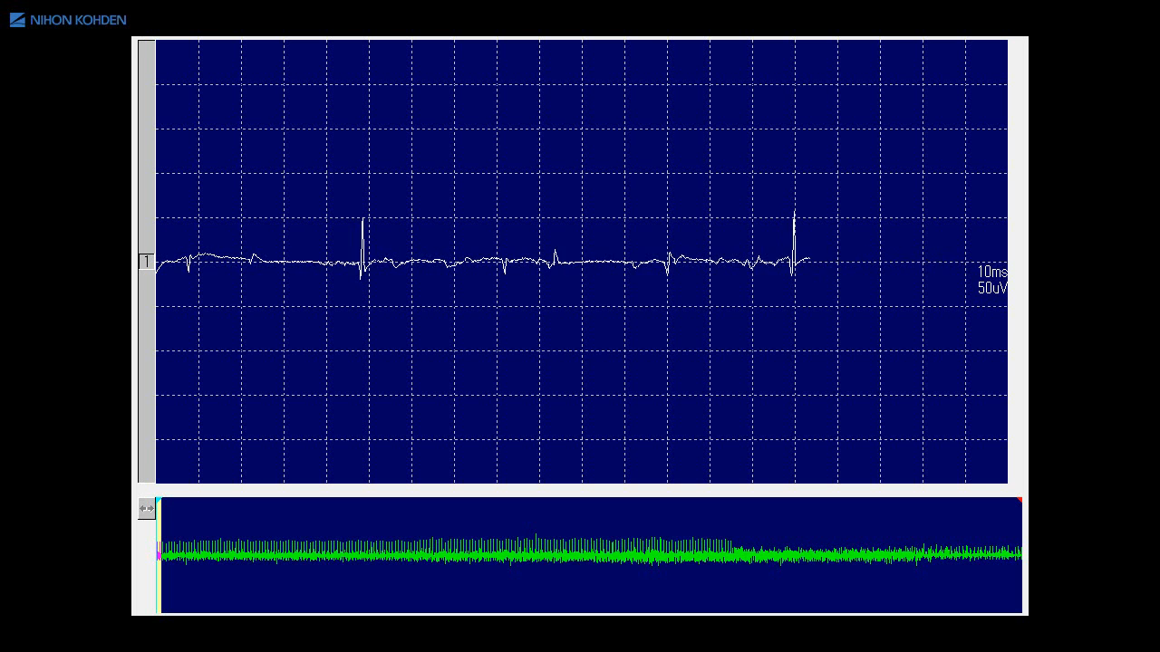
Amyotrophic lateral sclerosis
https://www.youtube.com/watch?v=9W_JmkotwQs
Orla Hardiman, 2017

Slide 13
Case 4

Slide 14
Guillain-Barré Syndrome

Slide 15
Case 5

Slide 16
Chronic Inflammatory Demyelinating Polyradiculoneuropathy (CIDP)

Slide 17
Case 6

Slide 18
Charcot-Marie-ToothDisease

Slide 19
Case 7

Slide 20
Brachial plexopathy

Slide 21
Case 8

Slide 22
DERMATOMYOSITIS

